Slide 1
ACCESS NI
Vetting your volunteers on Foireann
8th May 2024

Slide 2
FÁILTE
Notes:
Welcome everyone to the webinar
Thank them for giving up their time
Introduce myself & Bernie

Slide 3
HOUSEKEEPING

Slide 4
TORTHAÍ
What we will cover in the webinar:
Children’s Officer
Introduction to Access NI Vetting on Foireann
Creating an Account
The Role of Children’s Officer
Vetting Admin Access
Reviewing and approving/rejecting applications
Cancelling an application
Member certificate report

Slide 5
TORTHAÍ
What we will cover in the webinar:
Applicant
Applying for Access NI Vetting
Cancelling a Vetting Application

Slide 6
Access NI process
Applicant completes Access NI enhanced Disclosure Application via NI Direct Account and receives their 10-digit Access NI reference number.
Applicant uploads their ID documents to Foireann.
Club Children’s Officer verifies Applicant ID Documents on Foireann
Ulster GAA approve the form and the ID and send to Access NI
Access NI Process the form and issue the Disclosure Certificate directly to the applicant

Slide 7
Access NI process
Ulster GAA write to the applicant to confirm their vetting acceptance, this is updated on your Foireann profile and your club secretary receives a copy of your acceptance letter via email.
If there is information on your Certificate, Ulster GAA will write out to you requesting sight of the certificate in hard copy in its original form, it is vital that you send this on as soon as possible.

Slide 8
Access NI process
Ulster GAA risk assess all Enhanced Disclosure Certificates that contain information, where there are areas of concern, we will contact the applicant directly and meet with them to discuss before any decision with regard to their suitability for the position applied is made.
Where required, Ulster GAA will meet with club officers to discuss any areas of concern.
Applicants have the right to appeal any decision made by Ulster GAA in relation to their suitability for the position applied.

Slide 9
Important Information
Acceptance letters are valid for three years from the completion date at which stage they must be renewed.
When your application is due to expire, you will receive a reminder email.
A Paid and Voluntary Access NI application be in flight at the same time
No more than one paid or more than one voluntary application can be in flight at the same time.

Slide 10
DEMO
Stage 1: NI Direct (Bernie)
Stage 2: Foireann (Megan)
Creating an account / Vetting admin access
Applicant Flow
Children's Officer Flow
Member Certification Report
Stage 3: Cert Issued (Bernie)
Q & A (Bernie & Megan)

Slide 11
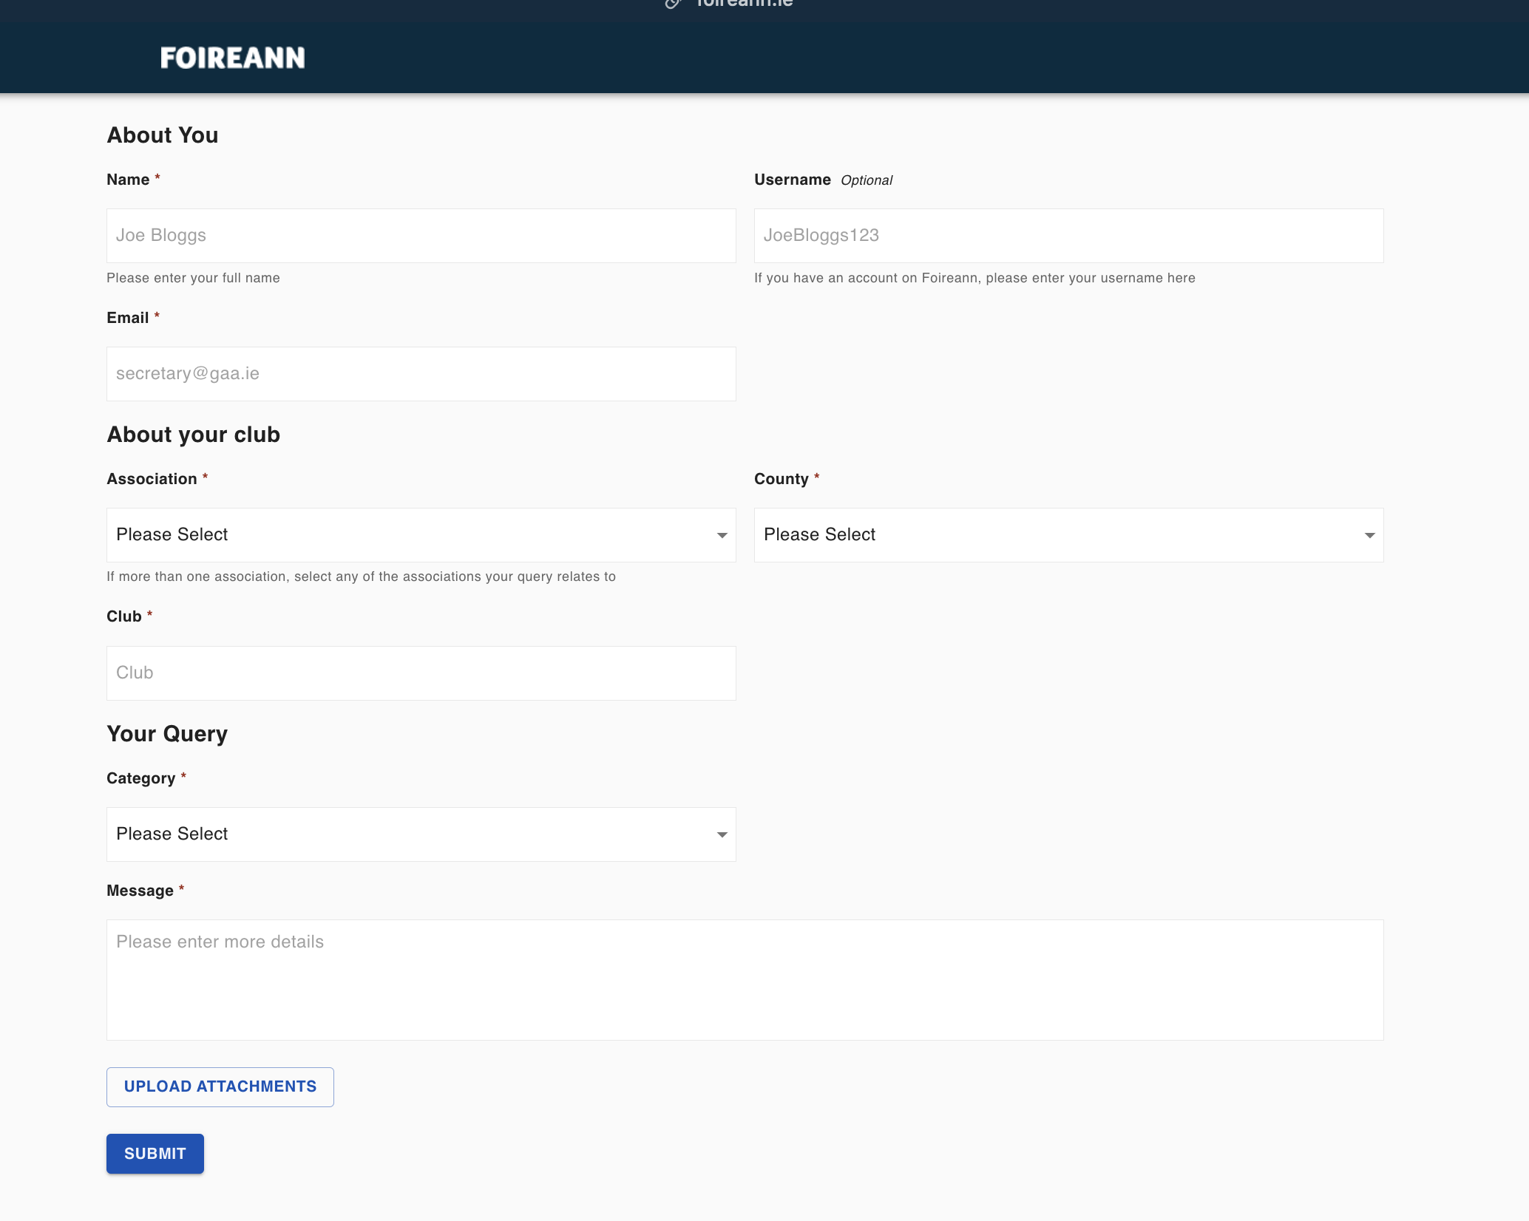
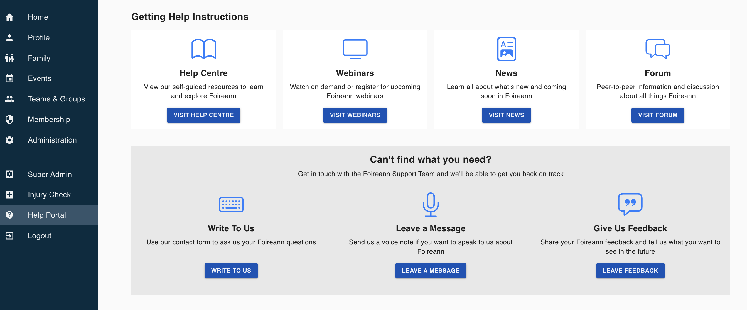
GO RAIBH MAITH AGAIBH
Help Centre: https://gmssupport.zendesk.com/hc/en-gb
Community Forum: https://gmssupport.zendesk.com/hc/en-gb/community/topics
Contact Forms:
Logged in Contact Form
Logged out Contact Form

